Slide 1
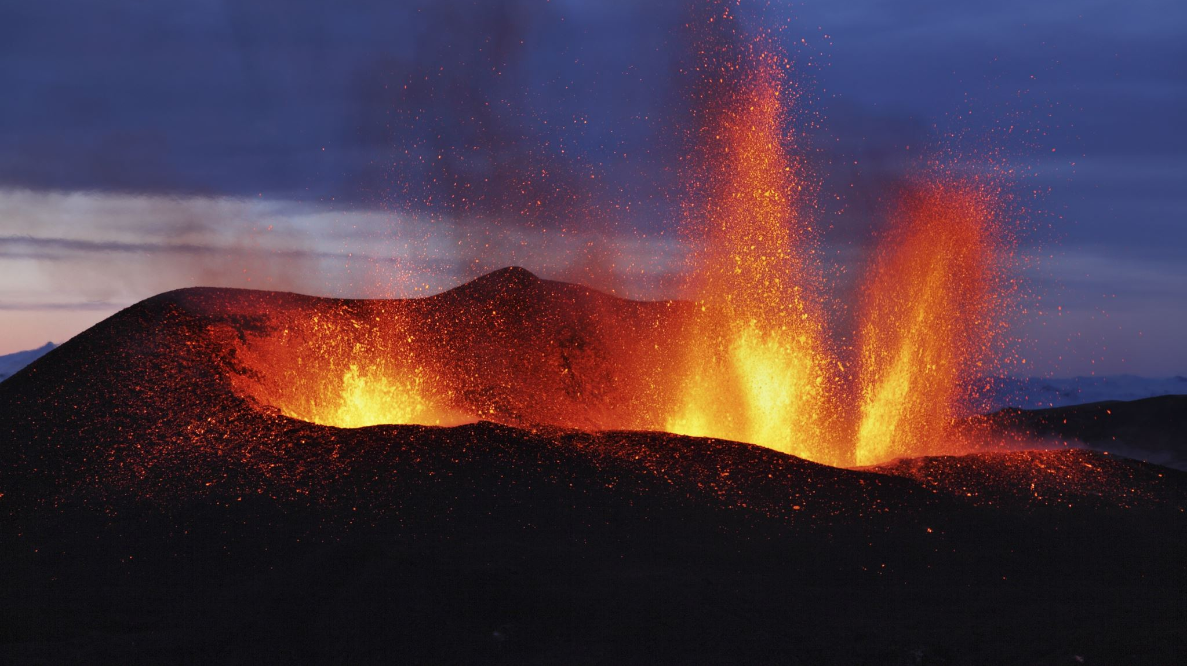

Volcanic
Eruption
Products
EART11300 Semester 2

Slide 2
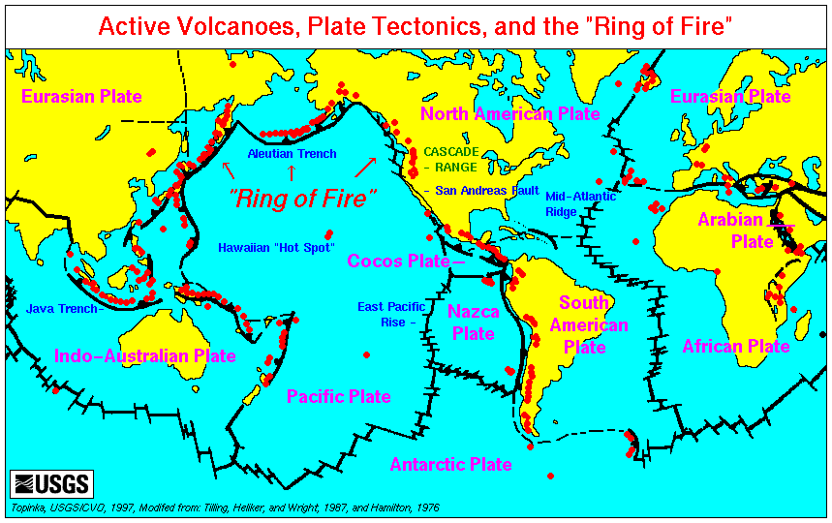
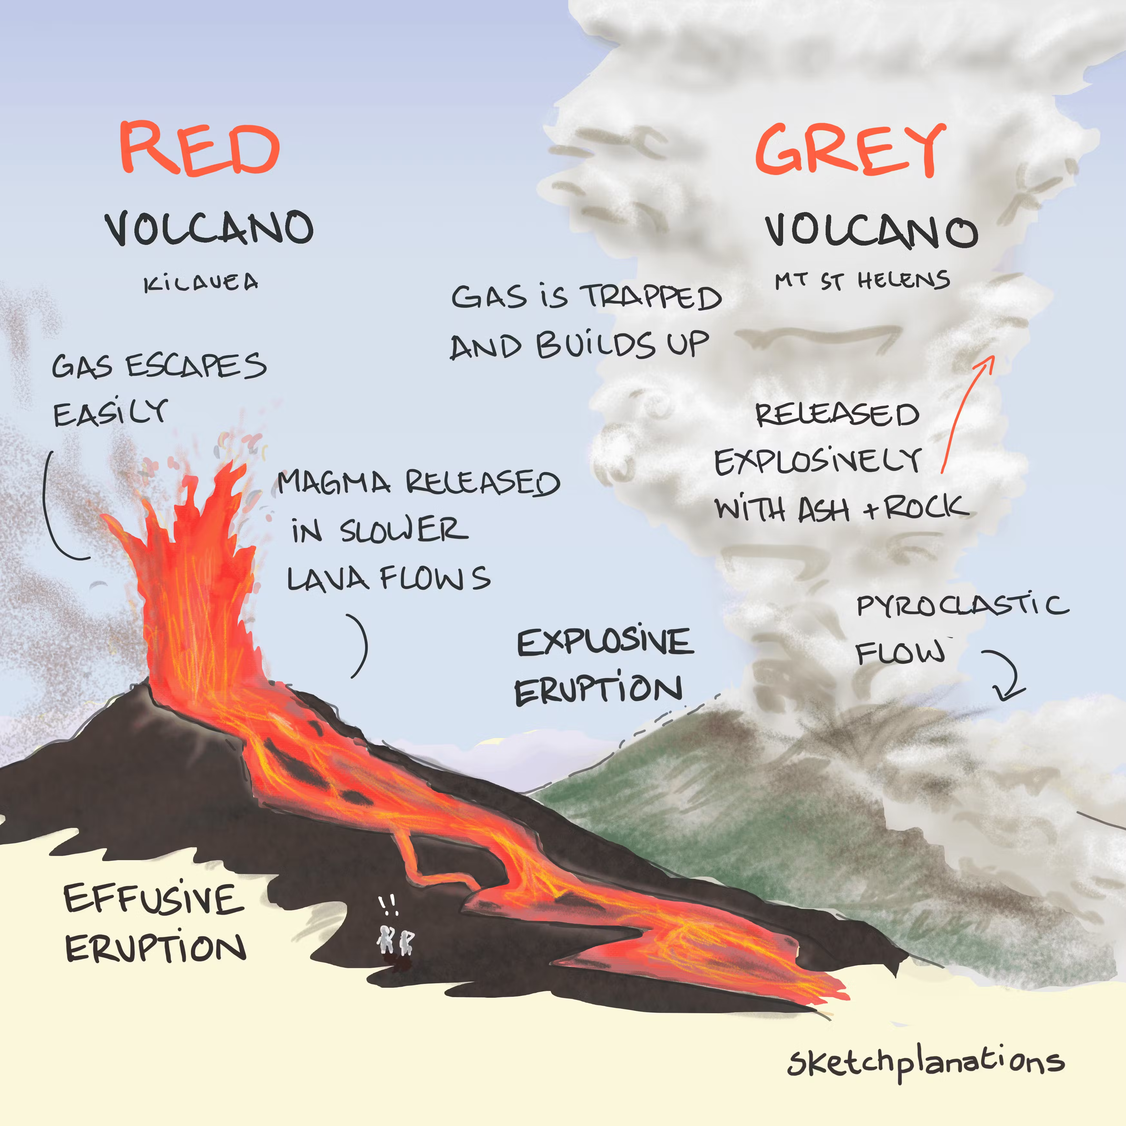
The Earth is home to hundreds of active volcanoes
Today we are going to explore the links between volcanic eruption style, tectonic setting, magma composition, volatile content, and the products (rocks) generated in eruptions.
Notes:
In this practical we are going to explore these two contrasting types of volcanism, in particular the tectonic settings where they occur, and with attention to the chemical and physical properties of magma (chemistry – silica content, volatile content; physics – viscosity)
We will study direct visual observations of eruption styles as well as hand specimens of volcanic eruption products (next week will explore volcanic landforms and begin to think about volcanism from the perspective of hazards and risk to life/society)

Slide 3
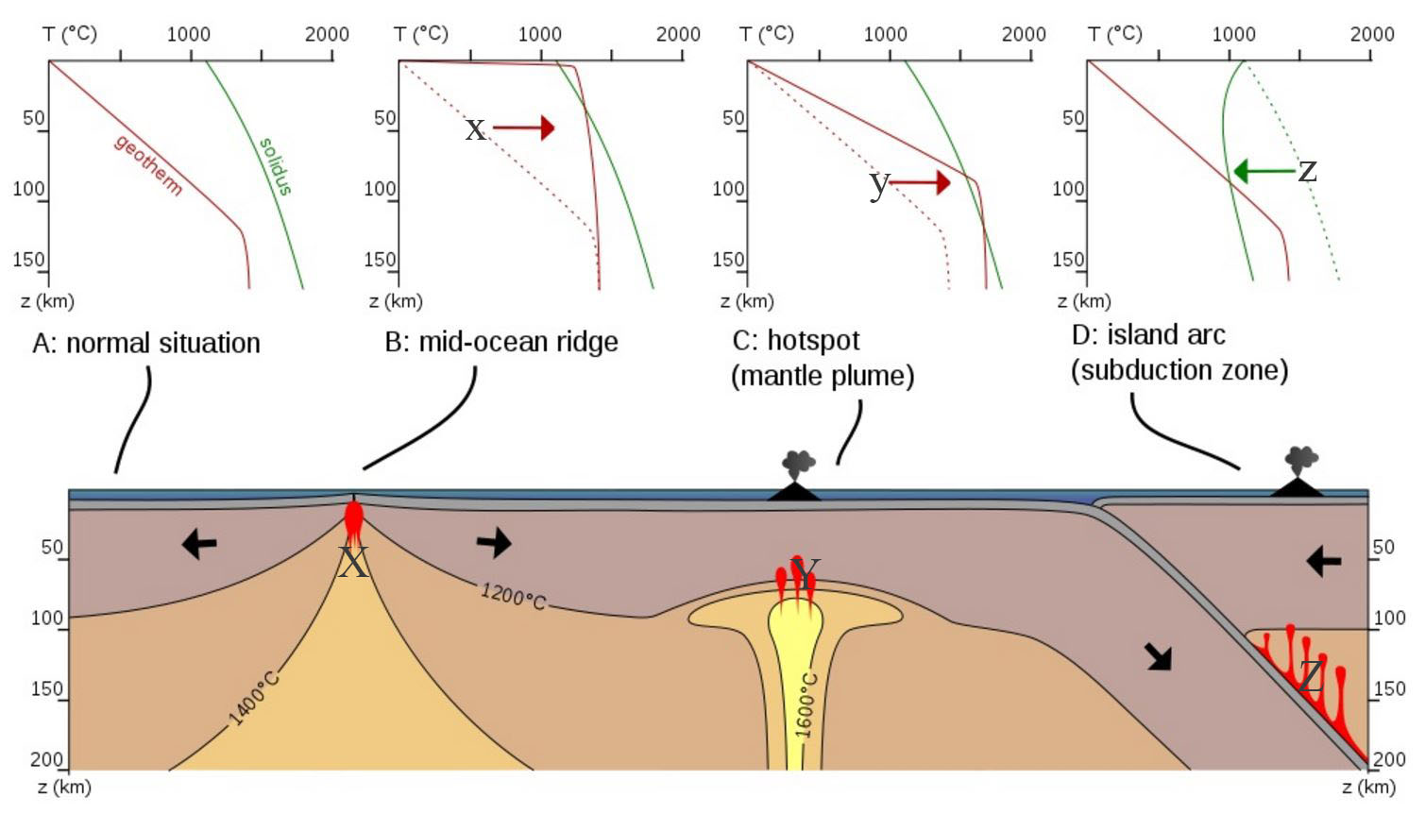
Tectonic setting and volcanism
Volcanism is a consequence of magma generation, i.e. partial melting of the solid mantle.
Magma is made by different processes in different tectonic settings.

Slide 4
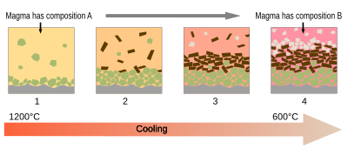
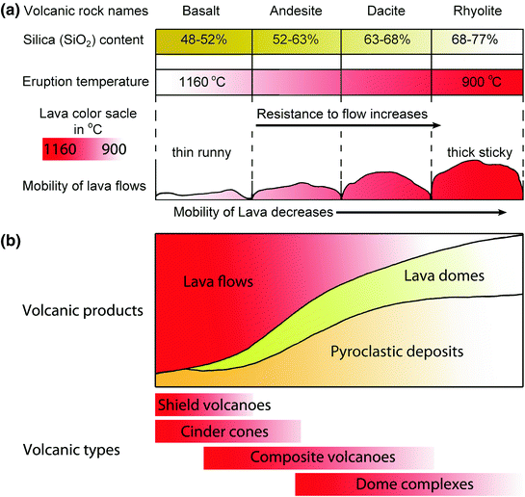
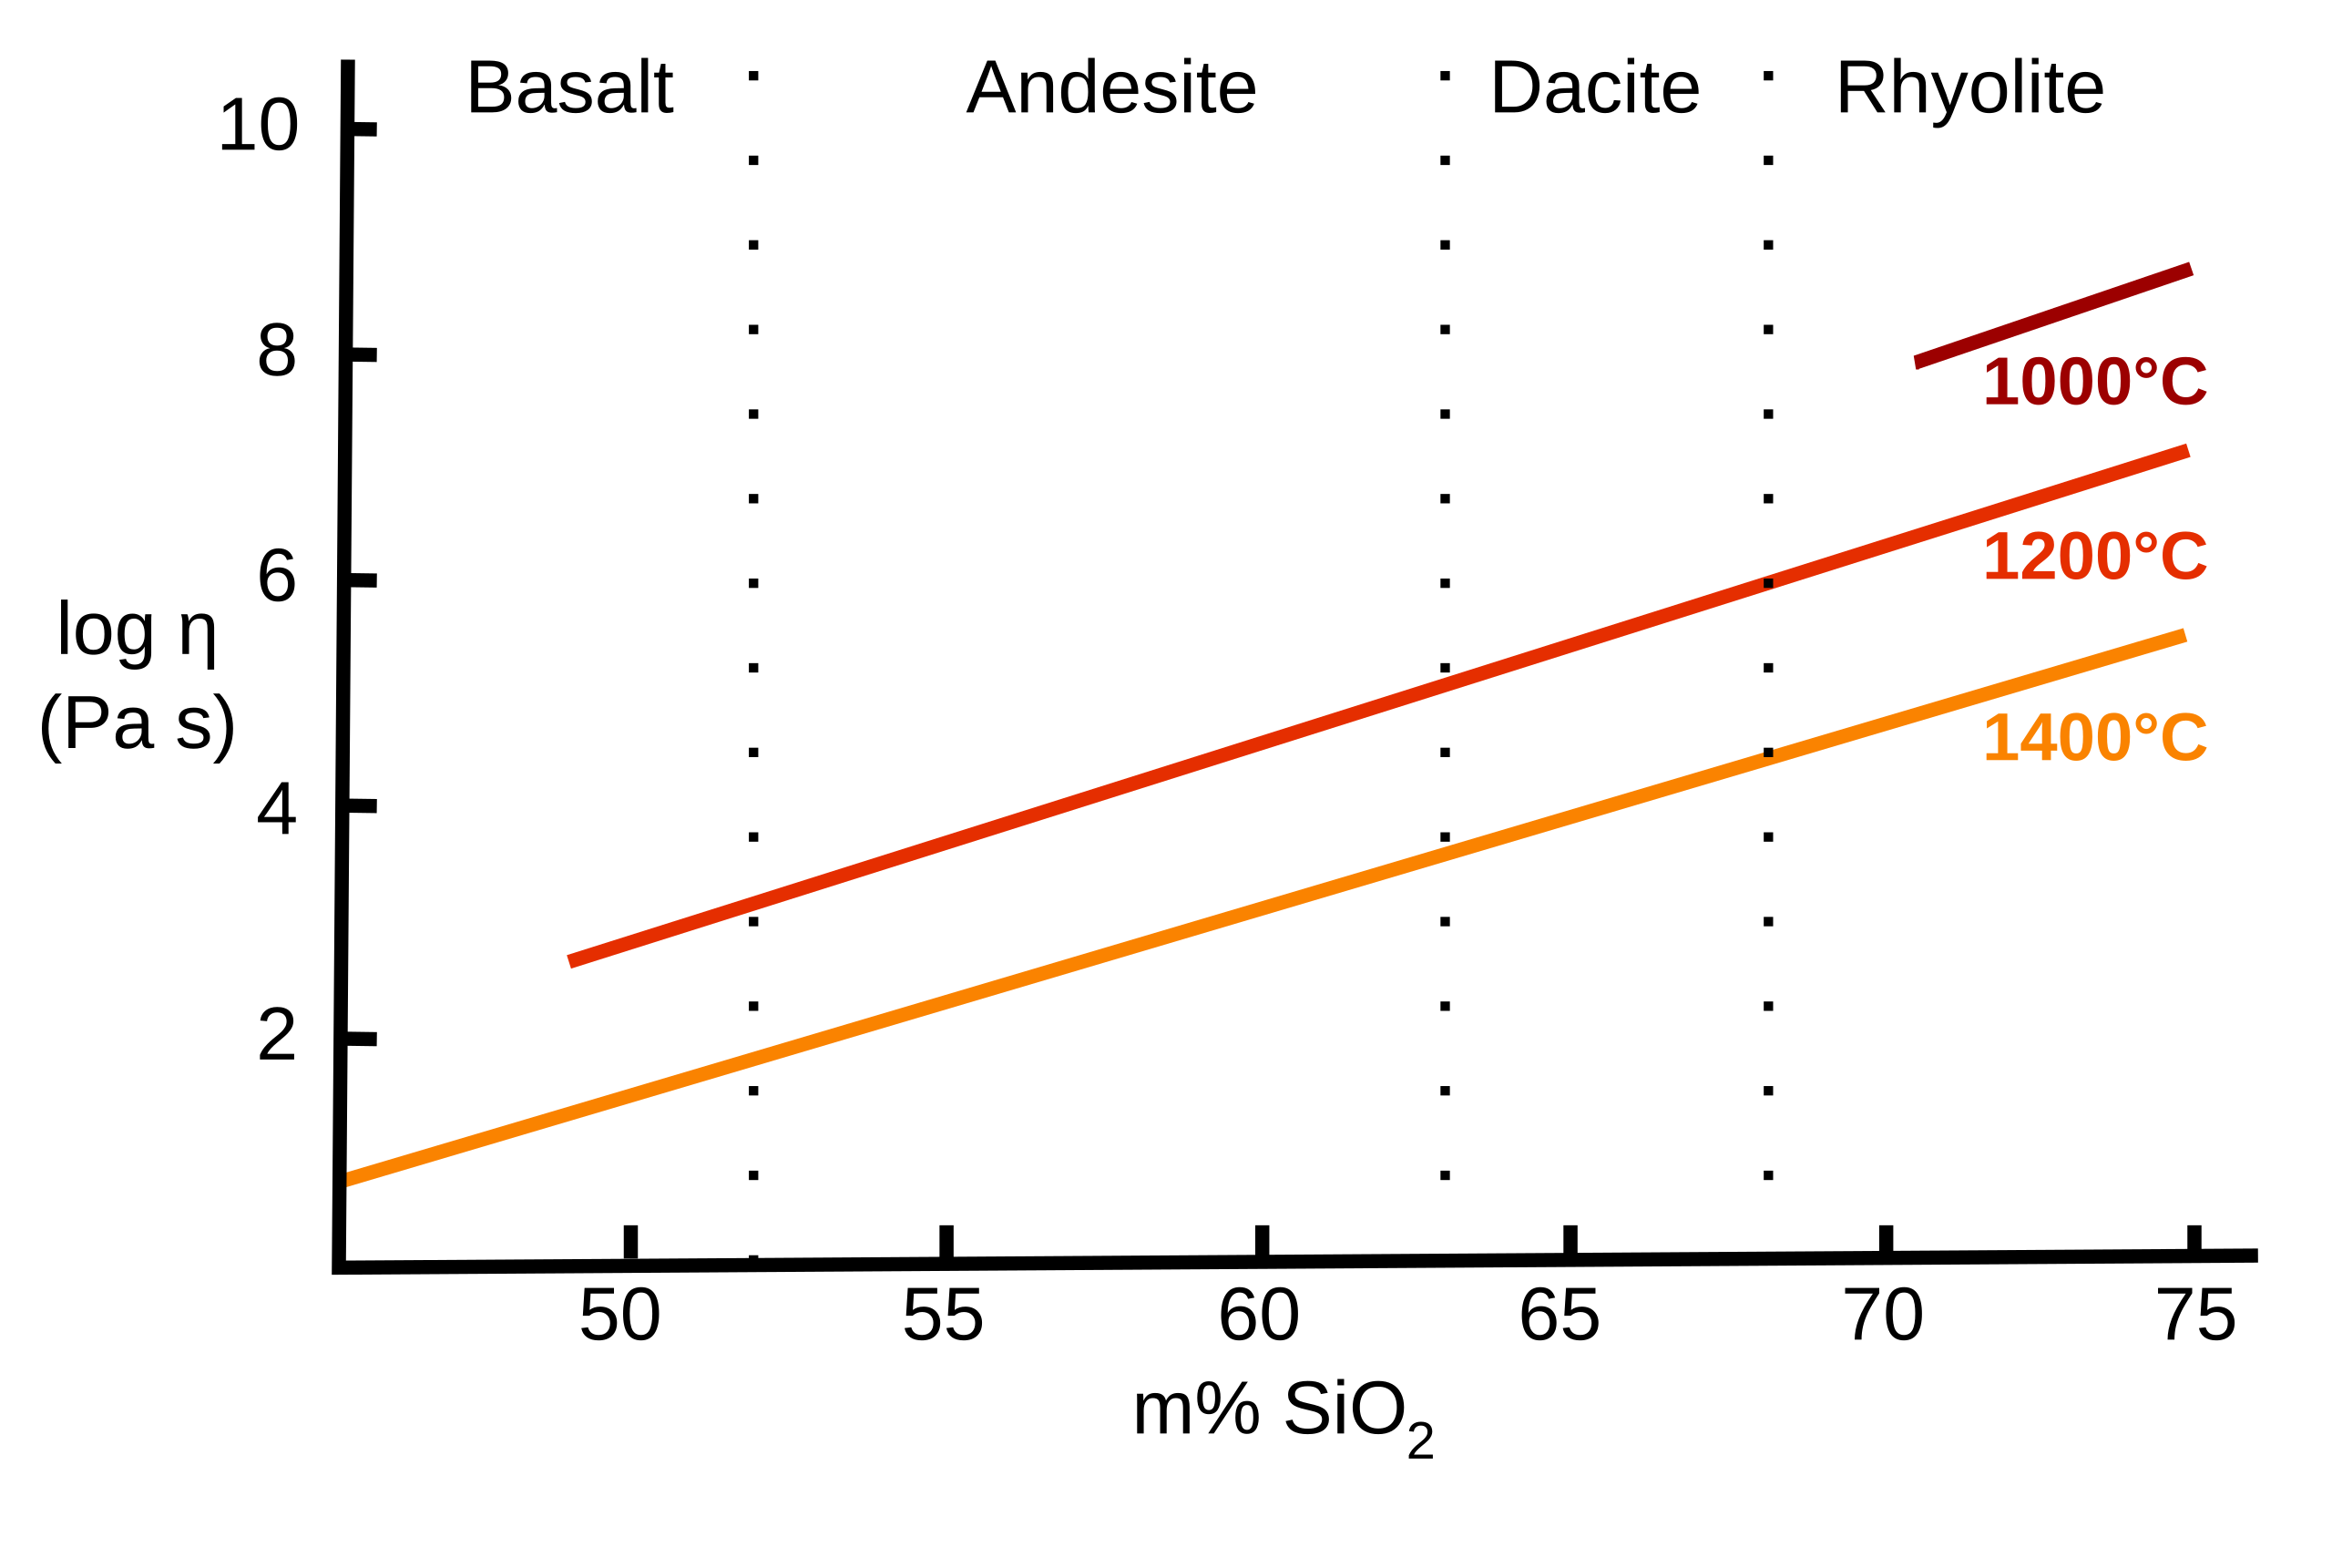
Magma chemistry & physics
Magma silica content changes during fractional crystallization
Magma viscosity strong depends on silica content (polymerisation)

Slide 5
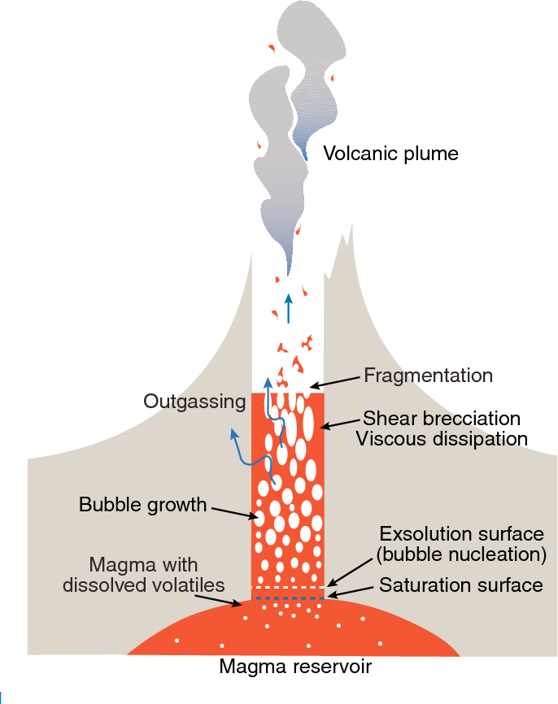
What are (effusive and explosive) eruptions?
All magmas contain volatiles: H2O, CO2, SO2, etc. The abundance varies between tectonic setting and as a function of composition (ask your demonstrators…).
Under crustal pressures, volatiles are (partly) dissolved.
As magmas ascend, volatiles exsolve / degas.
The viscosity of a magma determines whether gas bubbles can escape or not:
Low viscosity = easy bubble escape = magma erupts as a liquid (effusive)
High viscosity = bubbles can’t escape / growth is impeded = magma torn apart (“fragmentation”) as bubbles finally burst = magma erupts as pyroclasts (explosive)

Slide 6
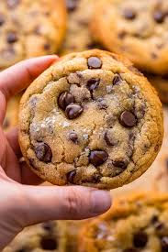
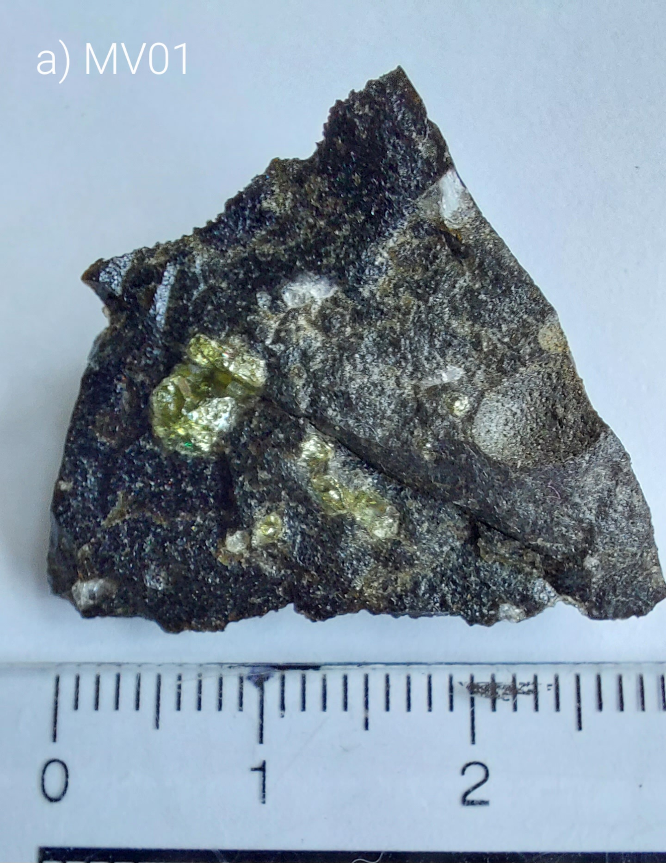
Can you describe the chocolate chip cookie?
If yes, you can describe a volcanic rock!

Slide 7
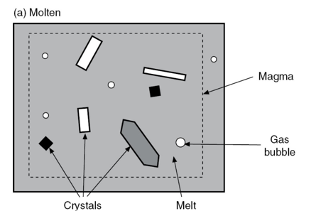
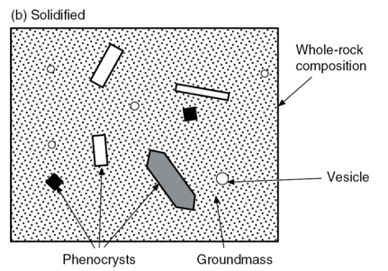

Slide 8
Your task is to describe samples of according to the following: [20 min per sample]
Size: What are the approximate dimensions of the sample in cm?
Shape: Is the sample rounded, angular, elongate or blocky? Does it have the same texture all over?
Colour: Is the sample light or dark in colour? Is it dull, shiny, or glassy? (Remember that mafic rocks (e.g., basalt) are generally (but not always) dark in colour and felsic rocks (e.g., rhyolite) light in colour)
Mineralogy: Are there crystals in the sample? If so, how large are they? What shape and colour are they?
Density: Is the sample light of heavy?
Vesicularity: Are there bubbles in the sample? If so, what are their properties (size, shape, abundance).
Eruption style interpretation: Given your answers to the above, infer a possible eruption style. In other words, did the rock form in an explosive or effusive eruption? Thinking about your answers to Part 1 may help here.

Slide 9
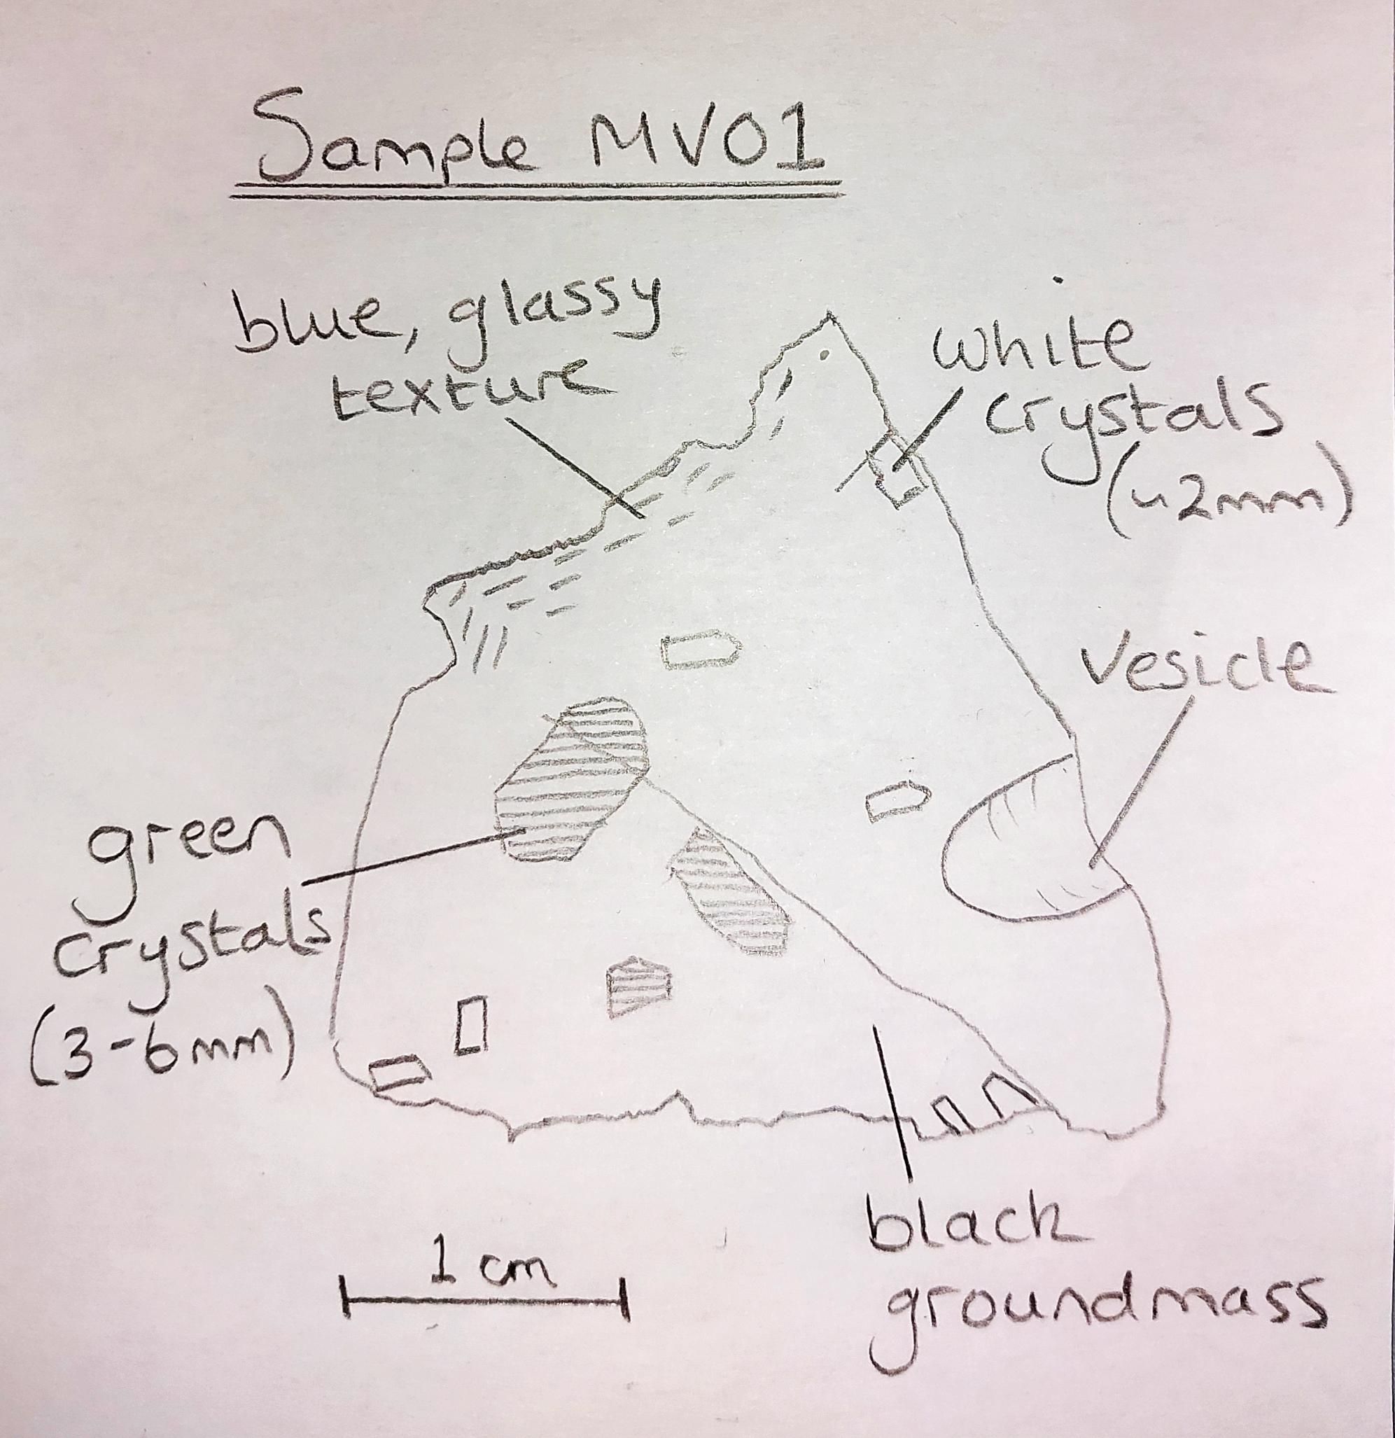

Sample MV01: Meradalir Valley, Fagradalsfjall, SW Iceland
Size: ~3 x 3 x 1 cm
Shape: Angular, broken from a larger body of rock.
Colour: Mostly black/some dark brown, rough groundmass. Blue, glassy regions on one side.
Mineralogy: Light green crystals up to 6mm. White crystals ~2 mm (<5% by volume)
Density: Heavy for its size, few vesicles → relatively high density
Vesicularity: One elongate vesicle ~6mm across longest axis

Slide 10
Sample MV01: Meradalir Valley, Fagradalsfjall, SW Iceland
Interpretations
Blue, glassy texture on surface (and fine-grained groundmass) → rapid cooling
Just one ~6mm vesicle → sample is not a product of explosive activity → sample is a product of effusive activity (lava flow)
Phenocrysts: green crystals = olivine, white crystals = plagioclase → typical of tholeiitic basalt
Black/dark brown→ mafic composition (relatively low silica, high Fe and Mg) → low viscosity basaltic magma

Slide 11
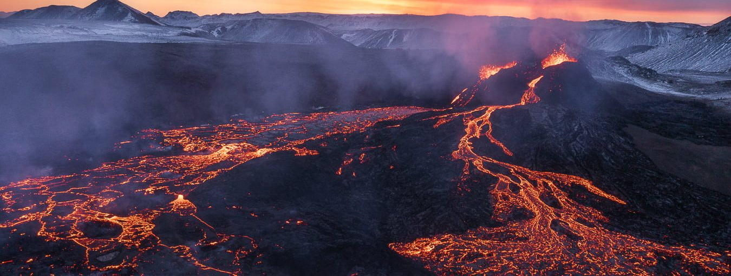
Sample MV01: Meradalir Valley, Fagradalsfjall, SW Iceland
This volcanic sample was produced by an effusive eruption (lava flow). The magma has a basaltic composition and is relatively volatile-poor. Such eruptions are typical of mid-ocean ridge / hot spot volcanism e.g. Iceland / Hawaiʻi.

